Slide 1
Sales Insight Dashboard (Atliq Hardwares)
Domain: FMCG(fast moving consumer goods) Function: Sales Tools Used: SQL, Power BI
Created by :HITHESH KUMAR H

Slide 2
Problem statement
Atliq Hardwares – a computer hardware business facing challenges to increase revenue in a dynamically changing market. The sales director needs a dashboard that can give him real-time sales insights that will provide him insights to increase revenue.

Slide 3
Project Objective
Build an interactive sales dashboard for real-time insights.
Track revenue and sales quantity across markets.
Identify top-performing products and customers.
Support leadership in strategic decision-making.
Improve overall sales visibility and performance

Slide 4
Data & Process
Imported raw data into MySQL for cleaning and preparation.
Used SQL queries to calculate key metrics (Revenue, Sales Qty, Trends).
Connected MySQL data to Power BI for visualization.
Created interactive filters (Year, Region, Product).
Designed visuals to highlight KPIs and performance trends.

Slide 5
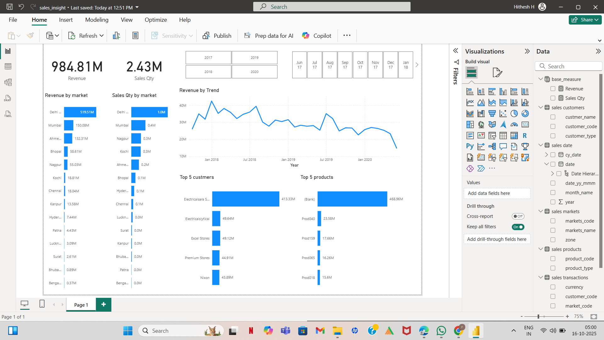
Dashboard

Slide 6
Features of the dashboard
The following 5 visuals were provided:
Revenue by Market – Compare sales across major cities.
Sales Quantity by Market – Measure regional demand.
Top 5 Customers & Products – Identify key contributors.
Revenue Trend Over Time – Track YoY performance.
Slicers for dynamic analysis by year and month.

Slide 7
Key Insights
Delhi generated the highest revenue (₹519M) among all regions.
Revenue shows a gradual decline from 2019 onwards.
Top 5 customers contribute ~70% of total sales.
Mumbai and Ahmedabad show potential for growth.
Clear visibility into high- and low-performing products.

Slide 8
Impact & Learnings(outcomes)
Dashboard enabled real-time sales tracking and insights.
Improved decision-making efficiency for the sales director.
Helped identify revenue improvement opportunities (~7%).
Strengthened understanding of business KPIs.
Gained hands-on experience in SQL, Power BI, and analytics.

Slide 9
Conclusion
The Sales Insight Dashboard for Atliq Hardwares successfully transformed raw sales data into actionable
business insights. By integrating SQL for data analysis and Power BI for visualization, the project provided
the sales director with a clear, real-time understanding of regional performance, top customers, and key
revenue drivers. This data-driven approach not only streamlined decision-making but also identified
opportunities for a potential 7% revenue growth in the upcoming quarter, demonstrating the value
of analytics in driving strategic business improvement.

Slide 10
Thank you!

